Slide 1
PSAT Night

Slide 2
PSAT
UNDERSTANDING
SCORES AND REPORTS

Slide 3
Benefits of Taking the PSATTM
Get a baseline of your college readiness.
Prepare for the PSAT/NMSQT® and SAT®.
Get free, personalized, and focused practice through Khan Academy®.
Start getting ready for college with college and career planning tools.
See which AP® courses for which you might be ready.
Notes:
The PSAT 8/9 is a preview of the content on the SAT and the PSAT/NMSQT, and can help them practice for both assessments. PSAT 8/9 scores, and all scores in the SAT Suite of Assessments, are accessible from the student’s online College Board account. In addition, the PSAT 8/9 offers other benefits.
1. If students link their College Board account with their Khan Academy® account, Khan Academy will use the PSAT 8/9 scores to design a practice plan and practice questions tailored to each student’s strengths and areas for improvement. This program is completely free, and practice test questions on Khan Academy are created with College Board approval, so this is the best SAT practice available.
2. The student’s online score report links to valuable tools for college and career planning. Students can use BigFuture™ and Roadmap to Careers to investigate their academic interests, colleges, and career options (more about BigFuture and Roadmap to Careers at the end of the lesson, slides 30-31).
3. PSAT 8/9 scores are indicators of ability to succeed in Advanced Placement® courses (for ninth-grade students). Students can find the AP® courses in which they are likely to succeed in the online reporting system (more information about the online reporting portal begins on slide 8).
4. If students opt in to Student Search Service® , they will begin to receive information about admission and financial aid from colleges that also participate in the program.

Slide 4
PSAT/NMSQT Scores
320-1520
160 to 760
8 to 38 range
8 to 38 range
1 to 15 range

Slide 5
PSAT 8/9 Scores
240-1440
120 to 720
8 to 36 range
8 to 36 range
6 Sub scores for 8/9
1 to 15 range

Slide 6
PSAT/NMSQT Score Report

Slide 7
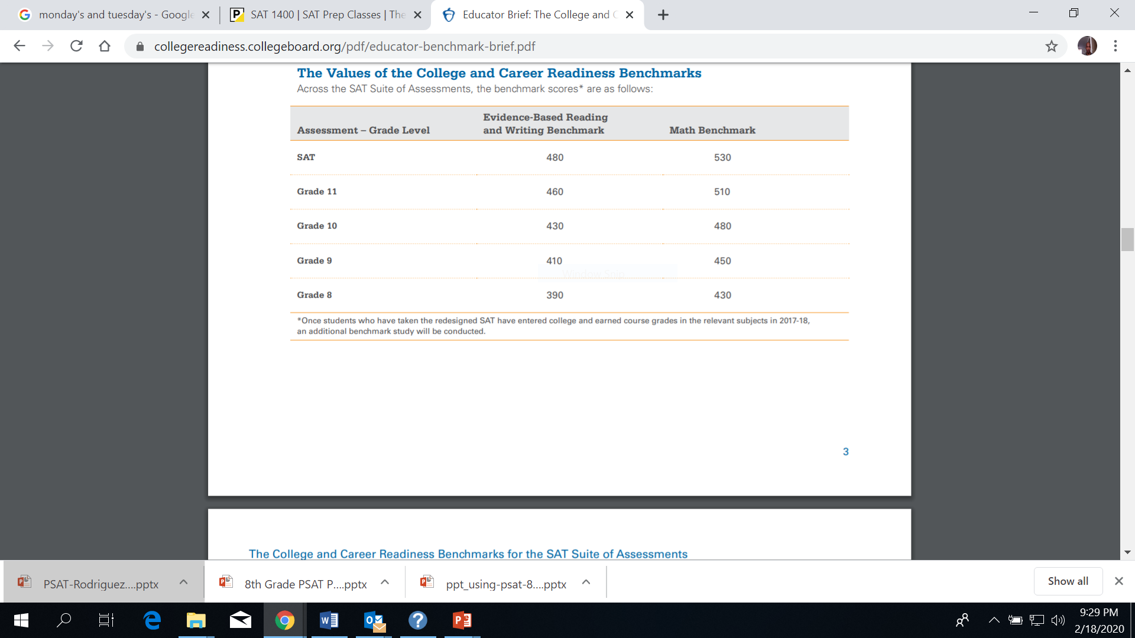
CCR Benchmarks

Slide 8
Good PSAT SCORES
 | EBRW | Math | Total Score
8th Grade | 480 | 480 | 960+
9th Grade | 520 | 510 | 1030+
10th Grade | 560 | 540 | 1100+
11th Grade | 620 | 580 | 1200+

Slide 9
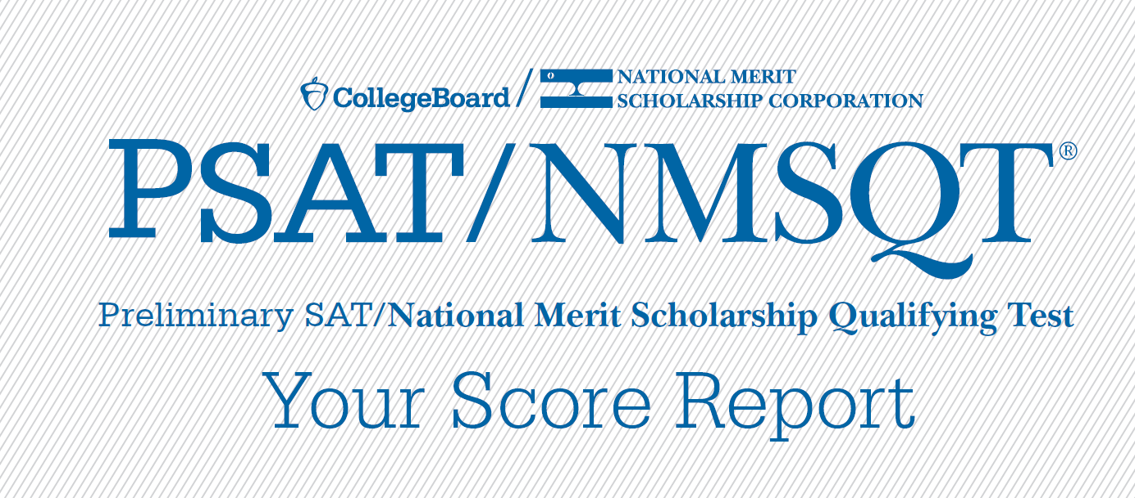
Understanding My Paper Score Report
9

Slide 10
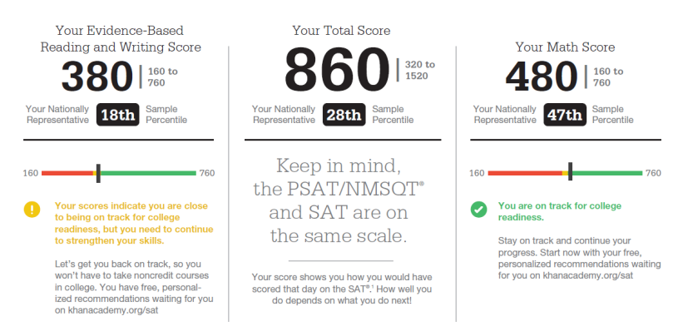
What Are My Scores?
10

Slide 11
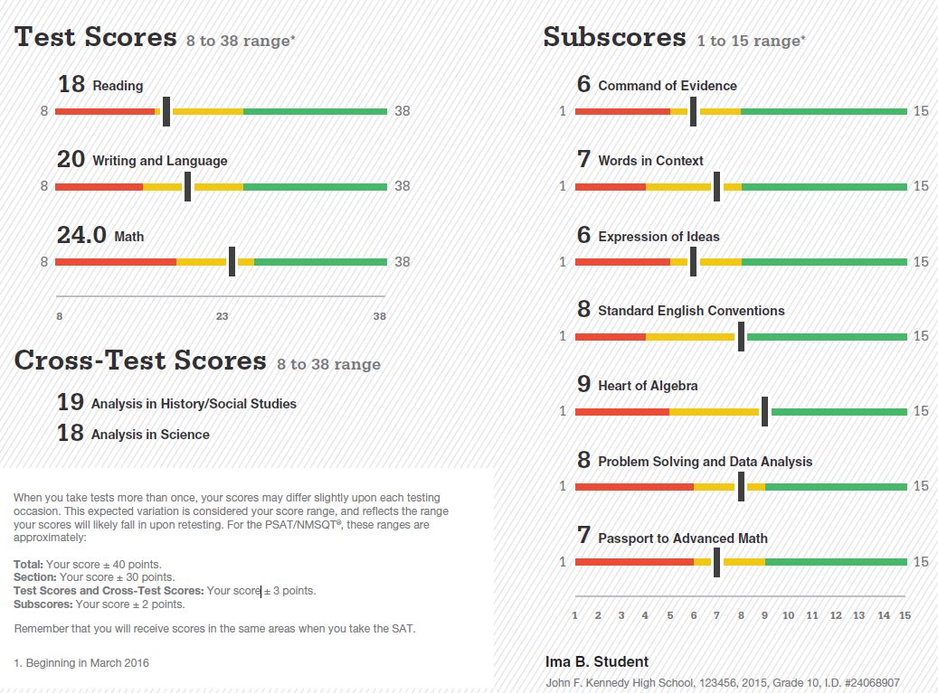
What Are My Scores? (cont.)
11

Slide 12
What Are My Score Percentiles?
12

Slide 13
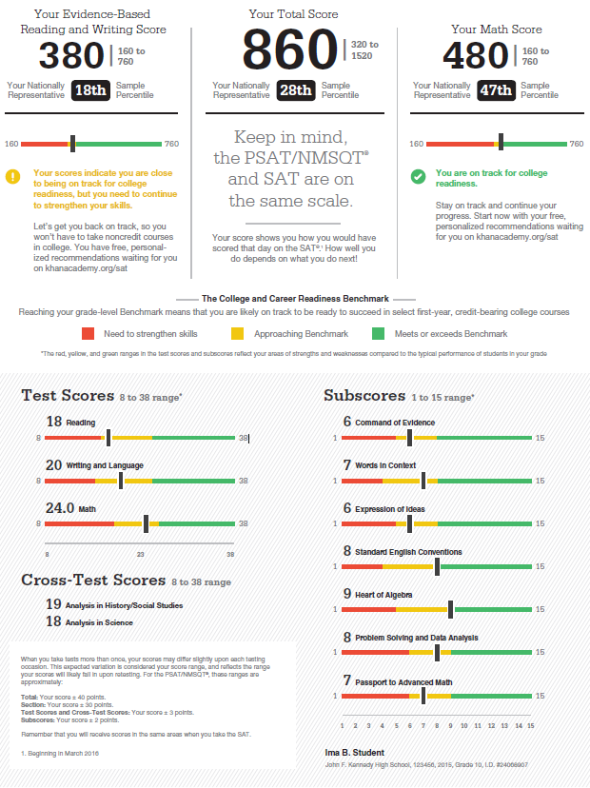
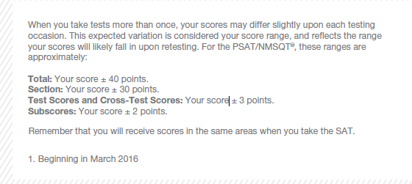
What Are My Score Ranges?
13

Slide 14
Student Reports - Login
Online scores will be available before paper reports
Access code needed only if name, address, DOB on account do not match
Educators can obtain access codes from K12 portal prior to receiving student paper reports
NOTE: All reports are subject to change and should not be considered final

Slide 15
Student Reports - Dashboard
Consolidated view of all assessment scores
Brief overview of each assessment including grade and year taken plus top level section scores
Includes pre-2015 PSAT/NMSQT scores
‘Report Details’ less detailed for pre-2015 PSAT/NMSQT
NOTE: All reports are subject to change and should not be considered final

Slide 16
Student Reports – Report Detail
Projected score ranges on next assessment
Percentile rankings
Tallies of correct and incorrect answers
NOTE: All reports are subject to change and should not be considered final

Slide 17
Student Reports – Skills Insight
Detailed explanation of current college readiness skills, based on test score band and typical students
Actionable steps to improve on skills required to be college ready
Each skill linked to applicable subscore categories
NOTE: All reports are subject to change and should not be considered final

Slide 18
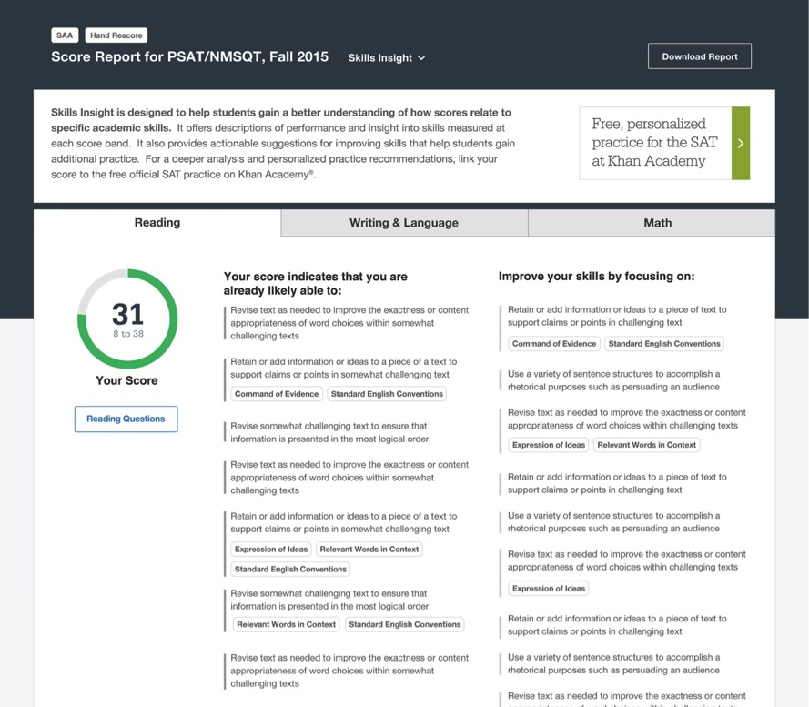
How Can I Improve My Academic Skills?
18

Slide 19
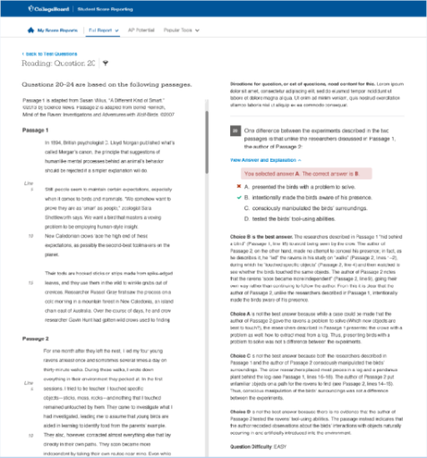
What Can I Learn From My Answers?
Look at my online score report
Identify the questions I answered incorrectly
Find the correct answer and read the answer explanation
Explain why the error was made
Ask questions about answer explanations that are not clear
19

Slide 20
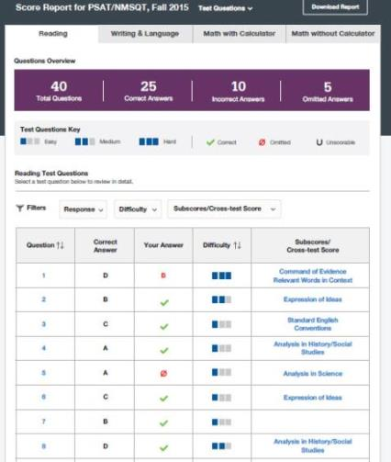
What Can I Learn From My Answers? (cont.)
Look at the types of questions I answered incorrectly and skipped:
Identify the level of difficulty. How many questions did I miss at each level?
Was I more likely to skip questions associated with any subscore or cross-test score?
What inferences can I make about areas for improvement based on the types of questions I missed and skipped?
20

Slide 21
What is My AP Potential™?
College Board research shows that students who score a 3 or higher on an AP Exam typically experience greater academic success in college and are more likely to earn a college degree on time than non-AP students.
AP Potential™ uses scores from the PSAT 8/9 and PSAT/NMSQT to provide predictions for 23 AP Exams.
21

Slide 22
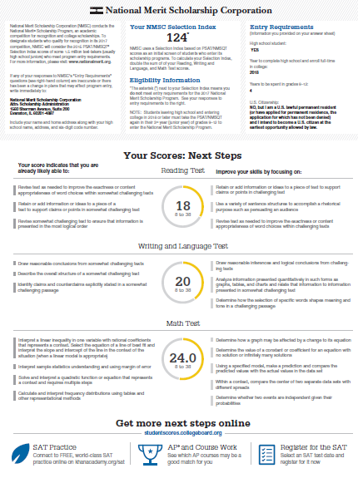
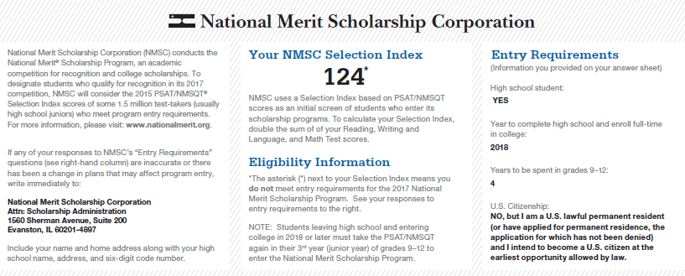
What is the National Merit® Scholarship Program?
22

Slide 23
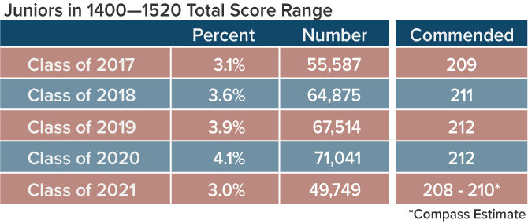
National Merit Semifinalist Cutoffs Class of 2021

Slide 24
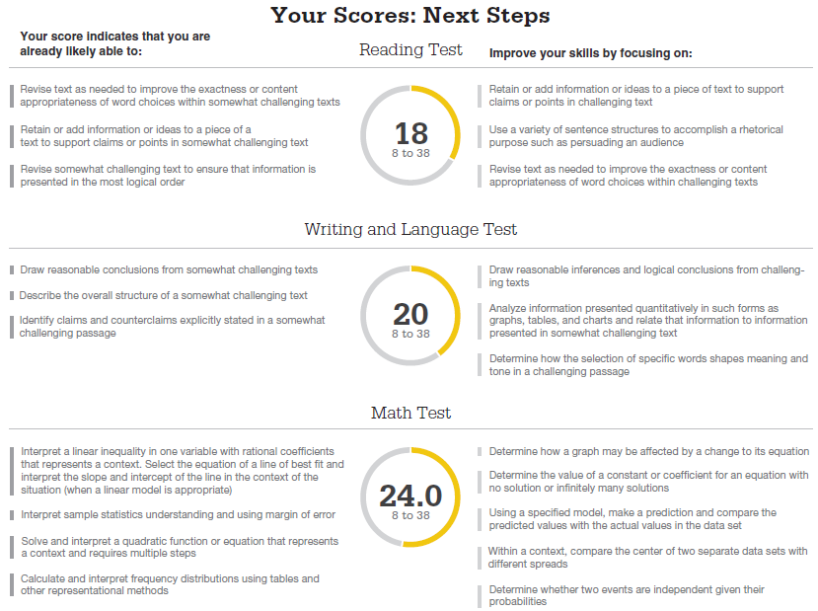
What Are My Areas of Strength? What Skills Do I Need to Build?
24

Slide 25
NATIONAL MERIT SELECTION PROCESS

Slide 26
Student Report
s – Additional Features
Popular Tools
Personality profile (MyRoad)
Career and college major exploration
College search
Scholarship search
Financial aid information and application
SAT registration
NOTE: All reports are subject to change and should not be considered final

Slide 27
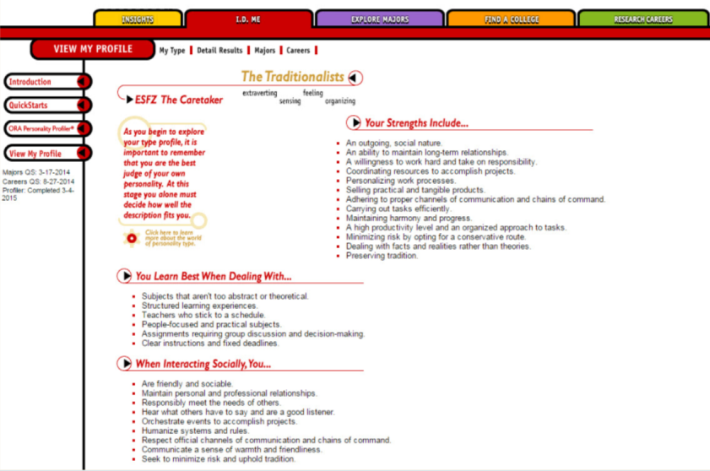
MyRoad™ Personality Explorer
27
Notes:
Once students are logged in, they are taken to their My Plan page. In My Plan, students can develop their own portfolios and resumes.
They can assemble information they' will need for college applications, brainstorm ideas for application essays, and record their interests and accomplishments for both college and career planning.

Slide 28
RESOURCES TO SUPPORT STUDENTS

Slide 30
Official SAT® Practice Through Khan Academy®
www.khanacademy.org/sat

Slide 31
Personalized SAT® Practice through Khan Academy
Send Score Data
Personalized Learning Roadmap
Official SAT Practice Tests

Slide 32
Currently Available on Khan
Feature | Description
Practice questions | Thousands of practice questions for math, reading, and writing co-developed with the College Board
Practice tests | Four full-length practice redesigned SATs written by the College Board with answer explanations
Diagnostic quizzes | Brief diagnostic quizzes for math, reading, and writing to gauge starting skill levels
Recommendations | Customized skills and tutorial recommendations based on your skill level and the proportion that topics are tested
Skills analysis | Summary of skills for math, reading, and writing and current performance and level on each skill
Tutorials | Customizable exercises and videos that allow you to review concepts and focus your practice

Slide 33
Additional Prep
Choices 360
https://www.dodea.edu/choices360/
Mr. Shaver’s tutoring
M&W ( 14:15 and 15:15)
Princeton Review
https://www.princetonreview.com/

Slide 34
Expanded Scholarship Opportunities
Increased access to over
$180 million in scholarships!

Slide 35
Student Search Service®
Student Search connects students with over 1,400 opportunities.
Student Search is now partnered with five additional major scholarship programs:
Hispanic Scholarship Fund
United Negro College Fund
Jack Kent Cooke Foundation
Asian & Pacific Islander American Scholarship Fund
American Indian Graduate Council
These scholarship organizations provide nearly
$180 million in scholarships

Slide 36
For More Information
collegereadiness.collegeboard.org

